Slide 1


ONLINE FOOD DELIVERY
Geo Simon (22P01091)

Slide 2


CONTENTS
1. Abstract
2. Introduction
3. Present and proposed system
4. Tools explanation
5. S/w and H/W requirements
6. System design
7. Screenshots
9. Future enhancement
8. Conclusion
10. References or Bibliography

Slide 3
ABSTARCT
The Online Food Ordering System is a modern web-based application designed to revolutionize the way restaurants operate and how customers interact with them. Its primary goal is to streamline restaurant operations while providing unparalleled convenience and accessibility to customers, thereby enhancing the overall dining experience for everyone involved.
Key to the system's functionality is its robust registration and login system, which allows both restaurant managers and users to create personalized accounts. This enables users to save their favorite restaurants, store payment information for quick and convenient ordering, and receive personalized recommendations based on their past orders and preferences. Similarly, restaurant managers can access their accounts to manage their menus, track orders, and analyze customer feedback. Overall, the Online Food Ordering System aims to bridge the gap between restaurants and customers in the digital landscape by providing a seamless and intuitive platform for food ordering and delivery. By offering a comprehensive set of features for both restaurant owners/managers and users, the system strives to enhance the overall dining experience, making it easier and more enjoyable for everyone involved.

Slide 4
INTRODUCTION
In today's fast-paced world, the food industry is undergoing a significant transformation with the advent of online platforms. The Online Food Ordering System emerges as a solution to meet the evolving needs of restaurants and customers alike. By leveraging the power of the internet, OFOS revolutionizes the way people discover, order, and enjoy food. This system caters to the diverse requirements of stakeholders within the food ecosystem. For restaurant owners and managers, it offers robust management tools to streamline operations, optimize menu offerings, and expand their digital presence. On the other hand, for customers, project provides a seamless and convenient way to explore culinary options, make informed decisions, and enjoy hassle-free ordering experiences. This paper delves into the architecture, functionalities, and benefits of the system. By examining its features such as user registration, restaurant search, menu browsing, and filtering options, we aim to highlight how the system enhances efficiency, accessibility, and satisfaction for both restaurants and customers. Additionally, we explore the technological advancements driving the adoption of such systems and the future prospects of online food ordering in the ever-evolving landscape of the food industry.

Slide 5
MAJOR MODULES:
Admin
Hotels
Users
Delivery Boys
Functionalities of Modules
ADMIN
Platform management oversight
Maintenance
Managing recruitment processes
Engaging with potential candidates with unparalleled efficiency.
HOTELS
Registration and login
Update menu or Change menu

Slide 6
Add multiple Hotels
Raise complaints
USERS
Registration and login
Order food
View Hotels
Make payment
View and Update of complaints
DELIVERY BOYS
Delivery Boy Registration
Update Registered Details

Slide 7
PRESENT &PROPOSED SYSTEM
PRESENT SYSTEM :-The existing system of an online food delivery project typically comprises a combination of manual processes, disjointed platforms, and fragmented operations. In this traditional model, customers primarily place orders through phone calls or visiting restaurant websites directly. This method lacks the convenience and efficiency that modern consumers expect, often resulting in longer wait times and potential errors in order placement. 6 For restaurants, managing orders from multiple channels, such as phone calls, walk-ins, and online orders, can be cumbersome and inefficient. Without a centralized system for order management, restaurant staff may struggle to keep track of incoming orders, leading to errors, delays, and potential customer dissatisfaction. Delivery logistics in the existing system are often handled manually or through third-party delivery services. This can lead to challenges in optimizing delivery routes, allocating drivers, and providing accurate delivery estimates to customers. Additionally, without real-time tracking capabilities, customers may experience uncertainty regarding the status and whereabouts of their orders.
PROPOSED SYSTEM:-The proposed system for the online food delivery project aims to address the limitations of the existing system by introducing a comprehensive and integrated platform that streamlines the entire food ordering and delivery process. The proposed system leverages modern technology to enhance user experience, improve operational efficiency, and ensure seamless interactions between customers, restaurants, and delivery personnel. Delivery logistics are streamlined through an intelligent routing and tracking system that optimizes delivery routes based on factors such as distance, traffic conditions, and delivery priorities. Delivery personnel receive real-time updates on order assignments, delivery addresses, and customer preferences, enabling them to provide efficient and timely service. Data management in the proposed system is centralized, with a robust database that stores menu information, customer profiles, order history, and transaction records. Advanced analytics capabilities provide insights into customer behavior, sales trends, and operational performance, empowering restaurants to make data-driven decisions and optimize their operations.

Slide 8
TOOLS
Front End Tool: HTML, CSS, JavaScript: For building the user interface and client-side functionalities.
React.js or Angular: Frameworks for developing dynamic and interactive web applications.
Bootstrap or Materialize CSS: Front-end frameworks for responsive design and UI components. 26 VSCode or WebStorm: Integrated development environments (IDEs) for front-end development.
Back End Tool: Python Django: Back end framework for building web applications with a clean and pragmatic design.
Django REST Framework: Toolkit for building Web API s in Django, facilitating communication between the front end and back end.
PostgreSQL or MySQL: Relational database management systems for storing and managing application data. Redis: In-memory data store for caching and session management. VSCode or PyCharm: IDEs for Python development and debugging.
Operating System: Linux (Ubuntu, CentOS): Stable and reliable operating system commonly used for web server hosting and development. Windows: Suitable for development environments, with support for various development tools and IDEs.

Slide 9
S/W and H/W REQUIREMENTS
HARDWARE
Processor | Intel Core i3
RAM | 4GB
HDD | 500GB
SOFTWARE
CLIENT SIDE TECHNOLOGIES | HTML, CSS, JAVASCRIPT
SERVER SIDE TECHNOLOGIES | PYTHON DJANGO, DJANGO REST FRAMEWORK
DATABASE | SQLyog ULTIMATE
WEB SERVER | XAMPP CONTROL PANEL
IDE | VISUAL STUDIO CODE or PYCHARM
WEB AUTHORING TOOLS | PHOTOSHOP, FLASH

Slide 10
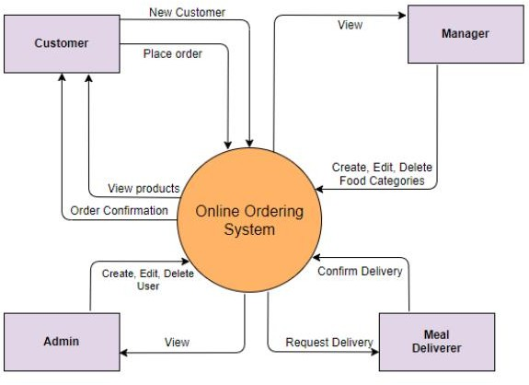
SYSTEM DESIGN
6.1 DATABASE SCHEMA DESIGN:
CONTEXT LEVEL

Slide 11
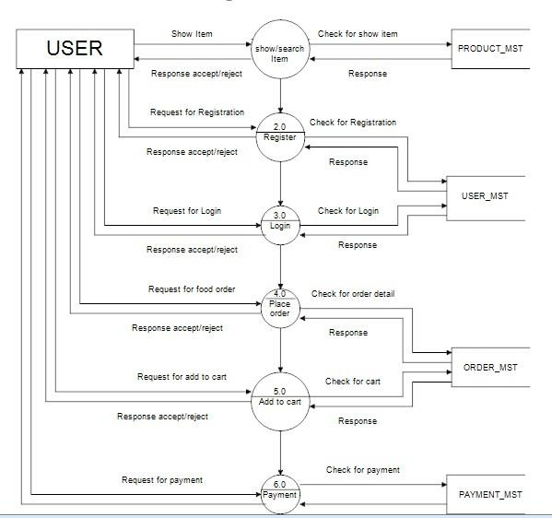
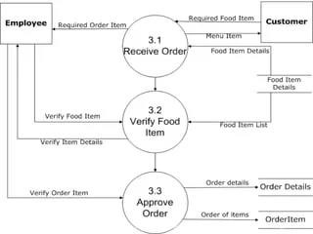
LEVEL 1

Slide 12
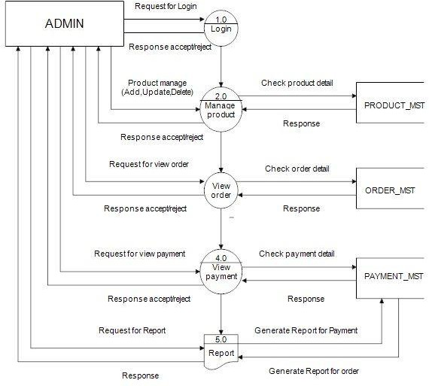
LEVEL 2

Slide 13
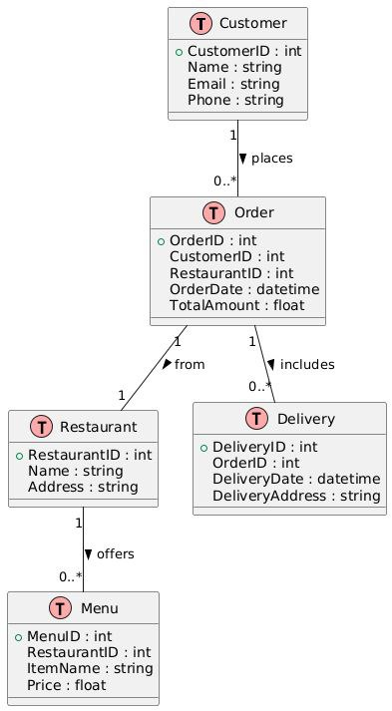
SCHEMA DIAGRAM

Slide 14
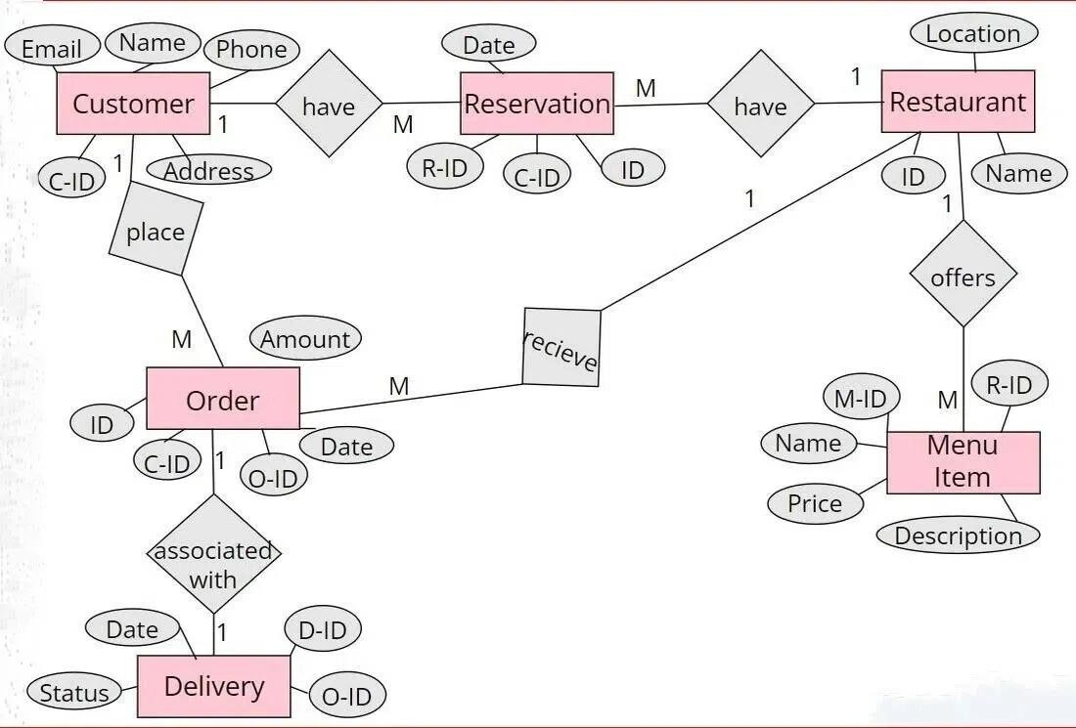
ER DIAGRAM

Slide 15
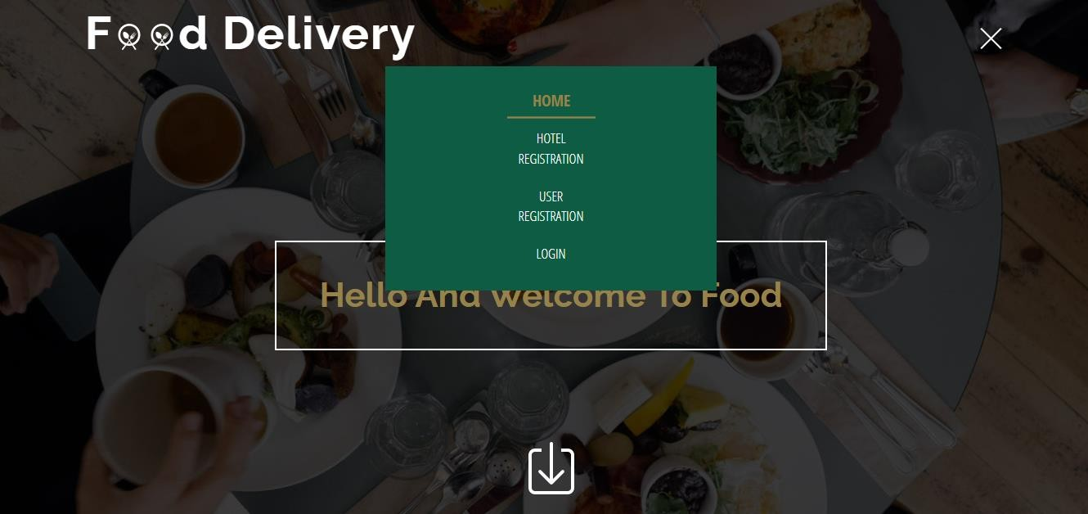
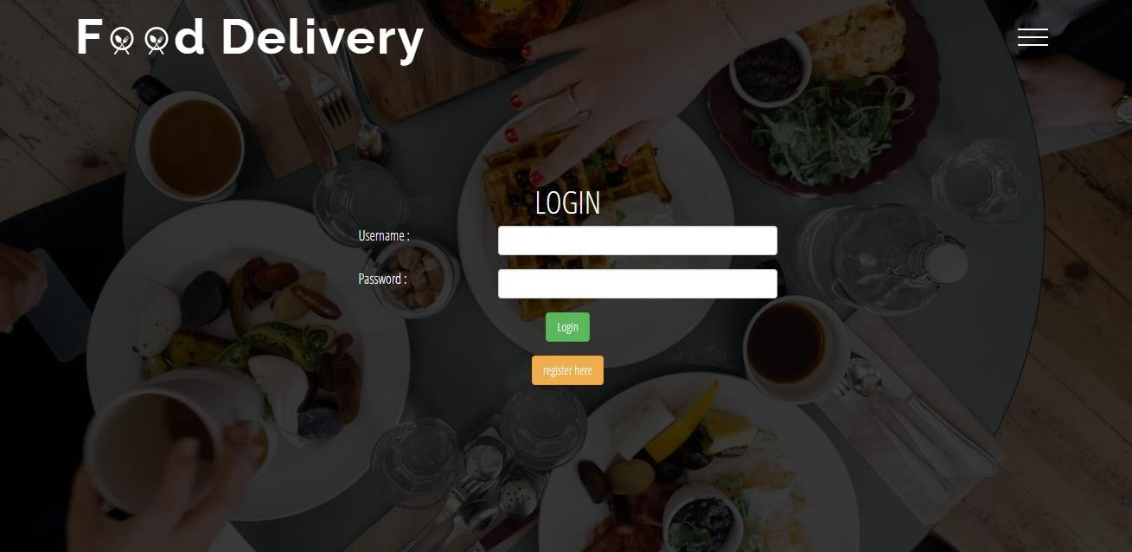
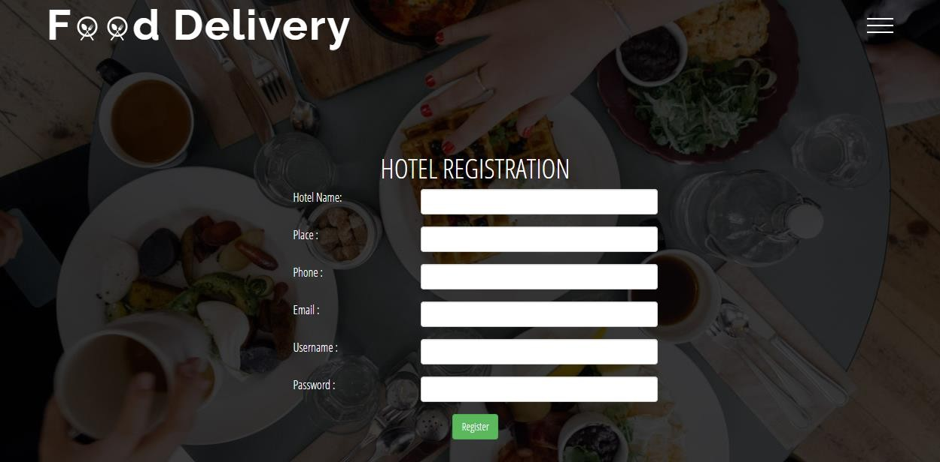
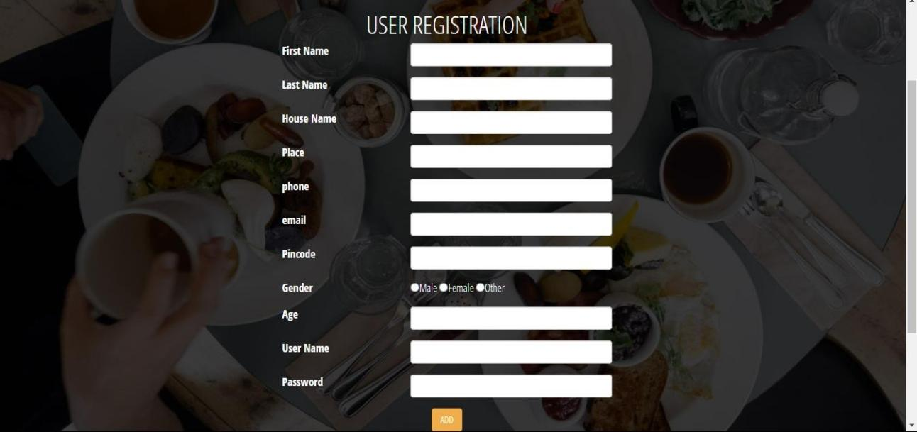
SCREENSHOTS

Slide 16
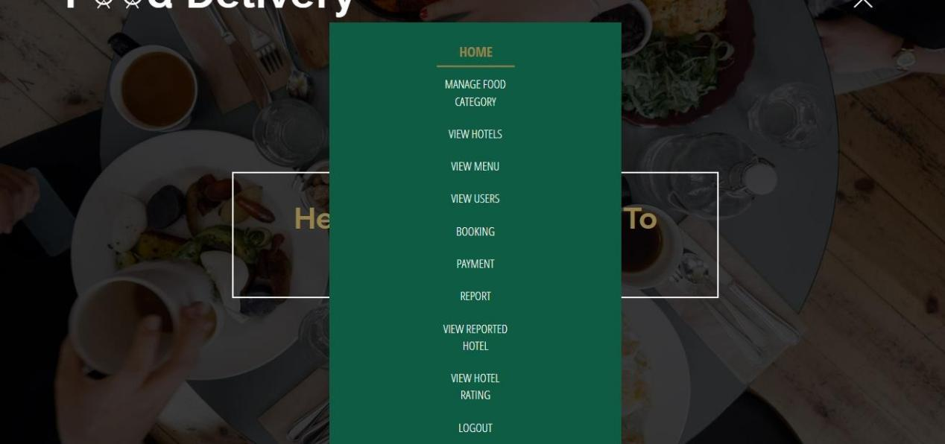
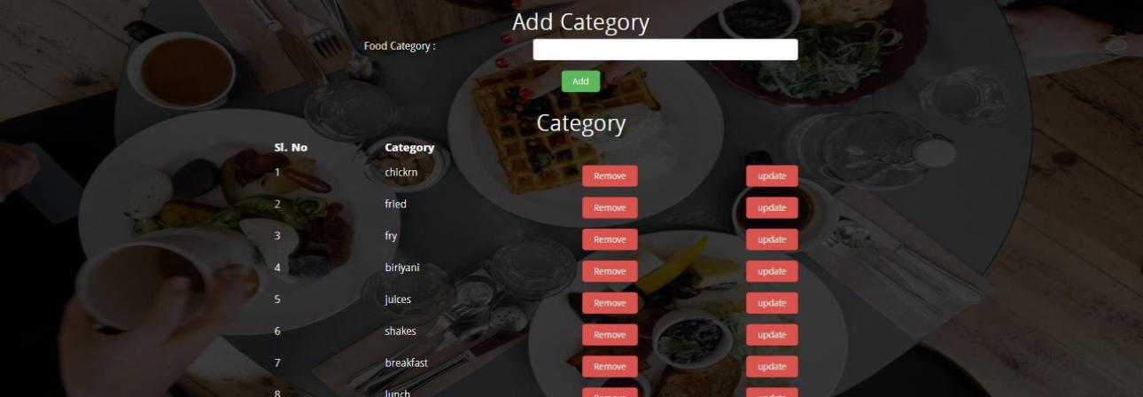
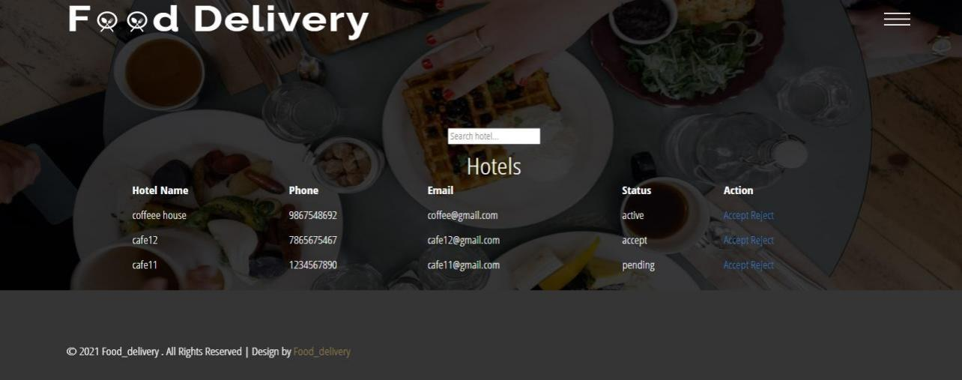
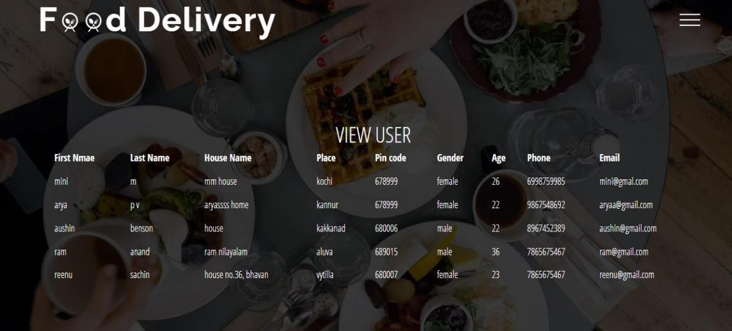

Slide 17
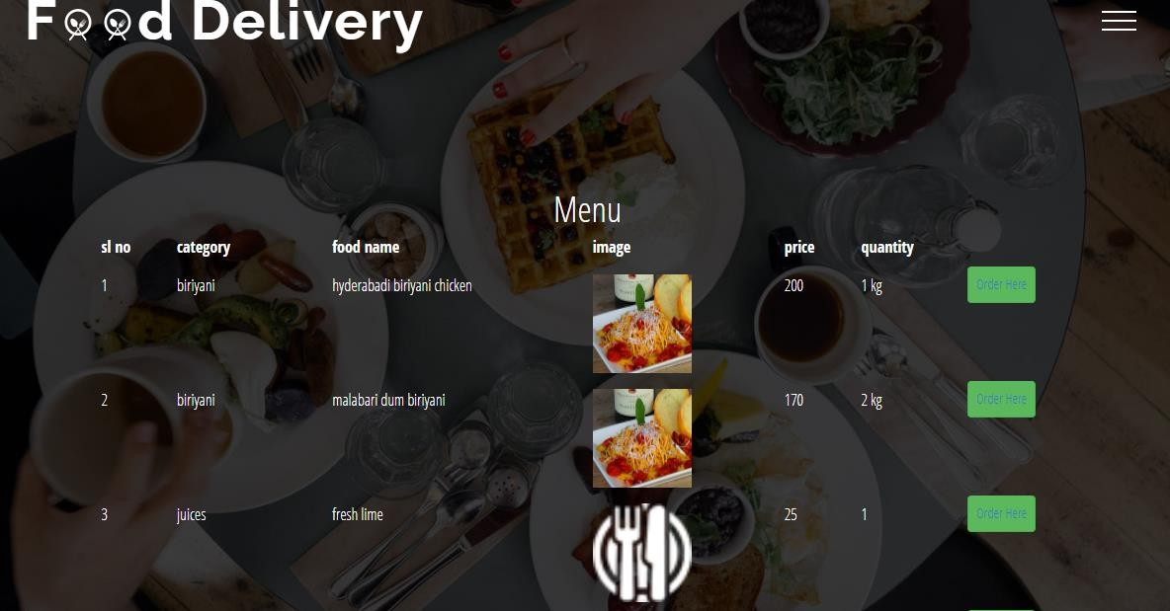
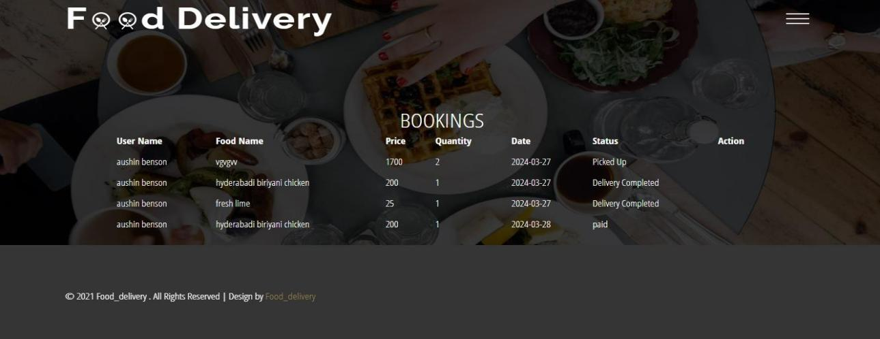
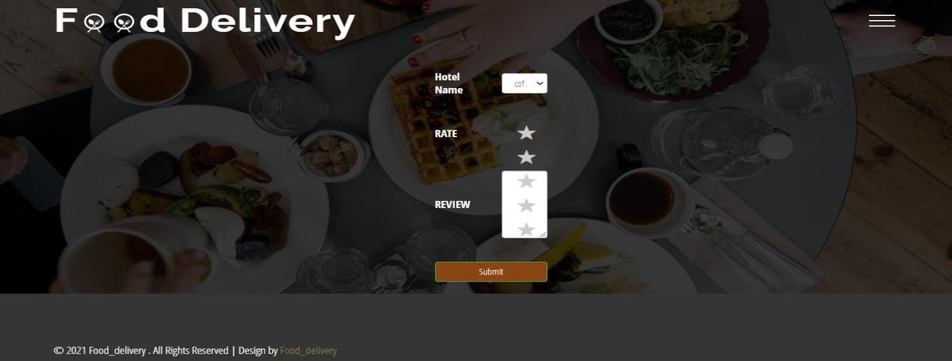
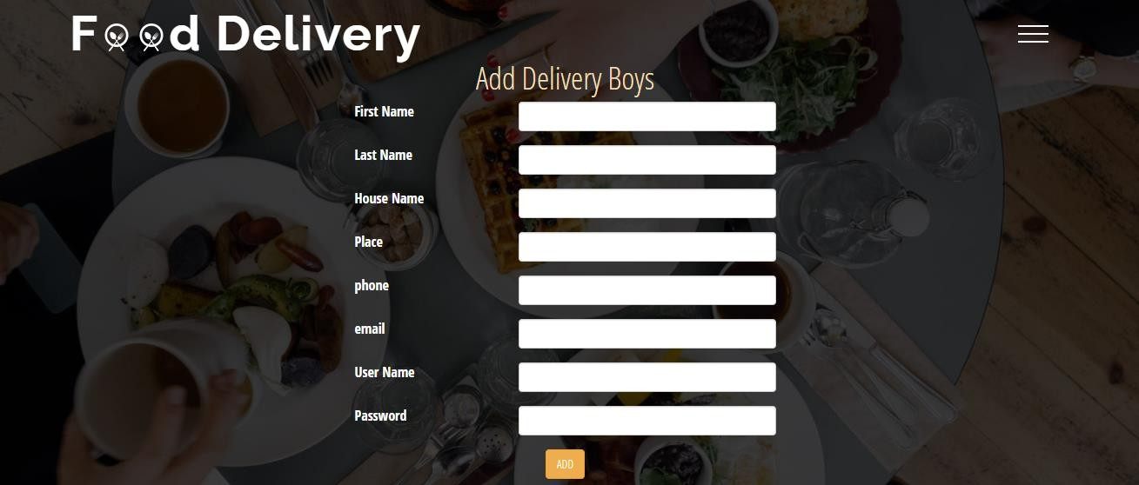

Slide 18
CONCLUSION & FUTURE ENHANCEMENTS
In envisioning the future enhancements of the online food delivery project, a multitude of innovative features and advancements come to mind, all aimed at elevating user experience, operational efficiency, and market competitiveness. One potential enhancement involves the integration of personalized recommendation systems powered by advanced machine learning algorithms. By analyzing user preferences, order history, and browsing behavior, the platform can provide tailored food recommendations, enhancing customer engagement and satisfaction by offering suggestions aligned with individual tastes and preferences. This feature not only simplifies the ordering process for users but also promotes exploration of new cuisines and dishes, ultimately driving increased order frequency and customer loyalty
FUTURE ENHANCEMENTS:
Personalized Recommendations: Implementing advanced machine learning algorithms to analyze user preferences, order history, and browsing behavior to provide personalized food recommendations. This feature would enhance customer engagement and satisfaction by offering tailored suggestions based on individual tastes and preferences.
Augmented Reality Menu Viewing: Introducing augmented reality (AR) technology to allow customers to visualize menu items in a virtual environment before placing their orders. This immersive experience would enable customers to make more informed decisions and enhance their overall dining experience.

Slide 19
Voice-Activated Ordering: Integrating voice recognition technology to enable customers to place orders using voice commands via virtual assistants or smart speakers. This hands-free ordering capability would offer convenience and accessibility, particularly for users with disabilities or those multitasking.
Drone Delivery Services: Exploring the feasibility of drone delivery services for faster and more efficient order fulfillment, especially in densely populated urban areas. Drone delivery could significantly reduce delivery times and costs while offering a unique and futuristic delivery experience to customers.
Blockchain-Based Food Traceability: Implementing blockchain technology to enhance food traceability and transparency throughout the supply chain. By recording and tracking every step of the food delivery process on a decentralized ledger, customers can have confidence in the origin, quality, and safety of their food orders.
Sustainability Initiatives: Introducing sustainability initiatives such as eco-friendly packaging options, carbon offset programs, and partnerships with local farmers and suppliers to promote sustainable and environmentally conscious practices throughout the food delivery process.
Integration with Emerging Technologies: Continuously exploring and integrating emerging technologies such as artificial intelligence, Internet of Things (IoT), and 5Gconnectivity to further enhance the platform's capabilities, improve operational efficiency, and stay ahead of market trends.

Slide 20
REFERENCES OR BIBLIOGRAPHY
BOOKS REFERRED:
Software Engineering by Roger Pressman
Database Systems by Abraham Silberschatz
Sqlyog Community – GitHub
WEBSITES REFERRED:
JavaScript https://javascript.info/
HTML https://html.com/
Bootstrap https://getbootstrap.com/
CSS https://www.w3schools.com/css/
MySQL https://www.javatpoint.com/mysql-tutorial
PYTHON https://www.python.org

